Slide 1
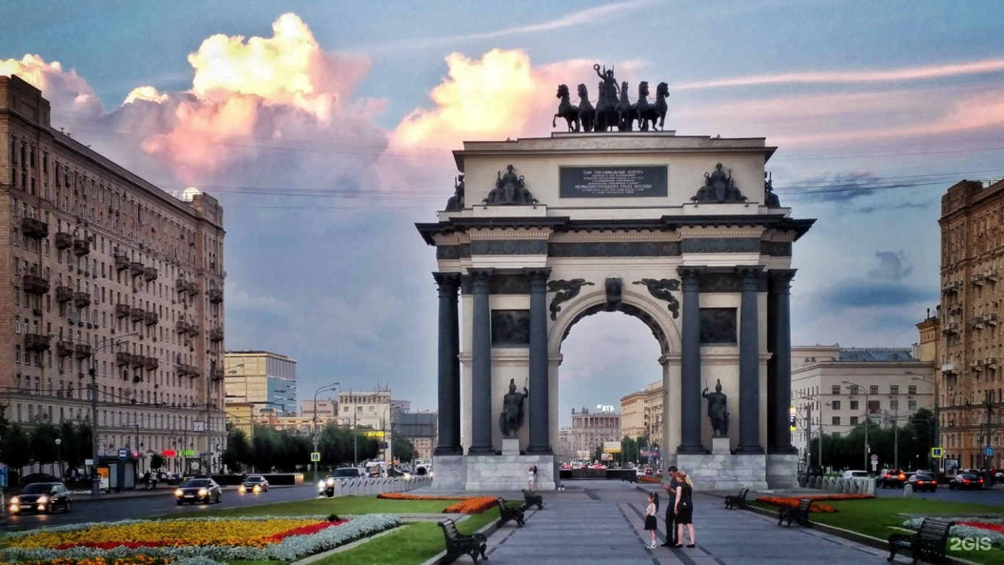
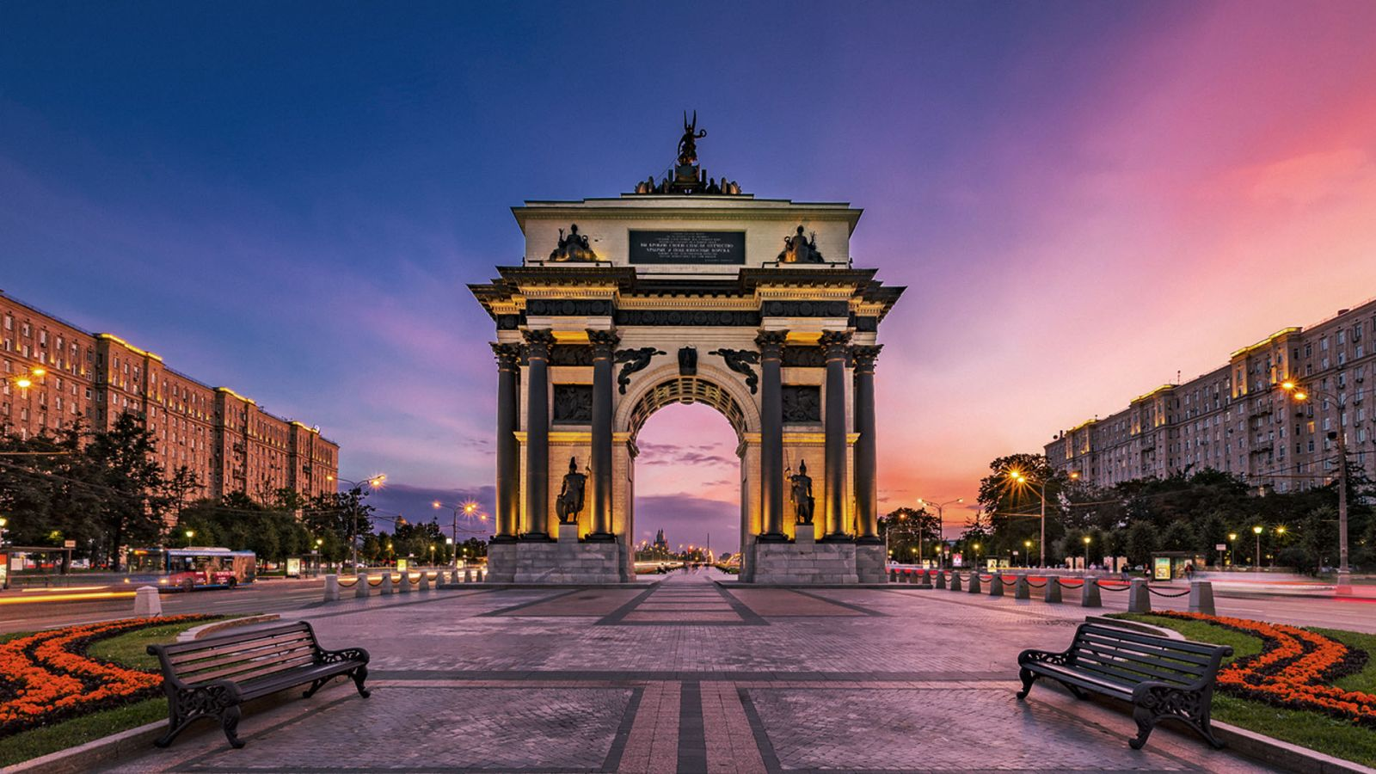
Performed by a student of the College
of MADC named after A. A. Nikolaev
Groups 1IP1
Abramova Alexandra Anatolyevna
The Triumphal Gate

Slide 2
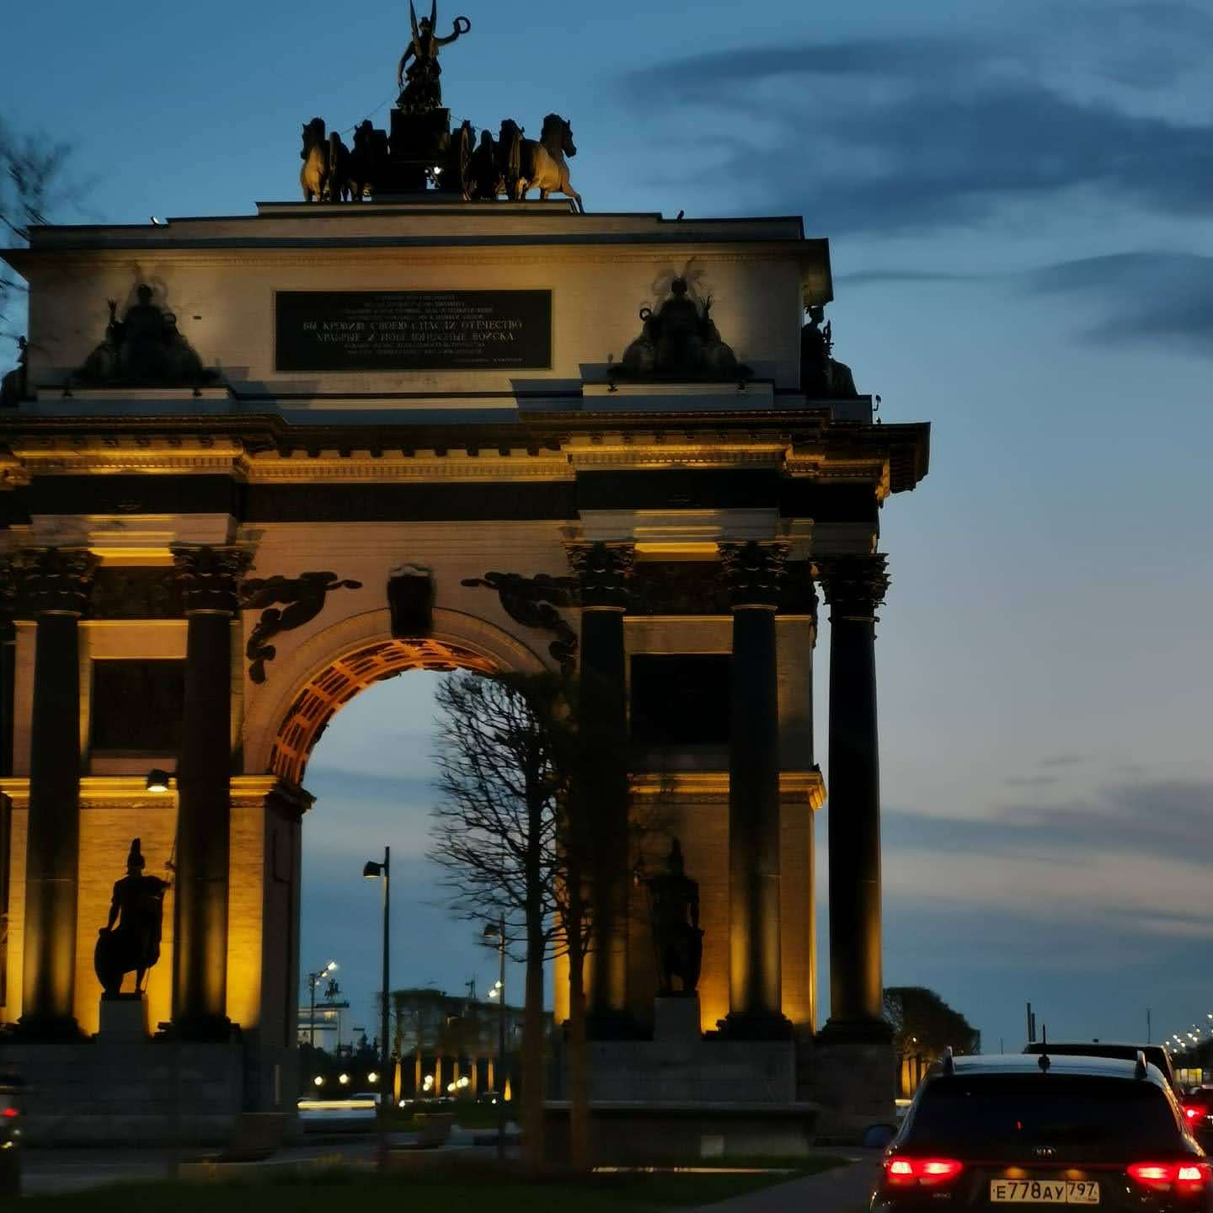
The Moscow Triumphal Gate (Triumphal Arch) is a triumphal arch in Moscow. Built in 1829-1834 on Tverskaya Zastava Square in honor of the victory in the Patriotic War of 1812. Dismantled in 1936. A replica of the gate was built in 1966-1968 on Kutuzovsky Prospekt or Victory Square in the Poklonnaya Gora area. The Triumphal Gate on Victory Square is one of the most recognizable sights of the capital. There are few people left who saw the structure in a completely different place.

Slide 3
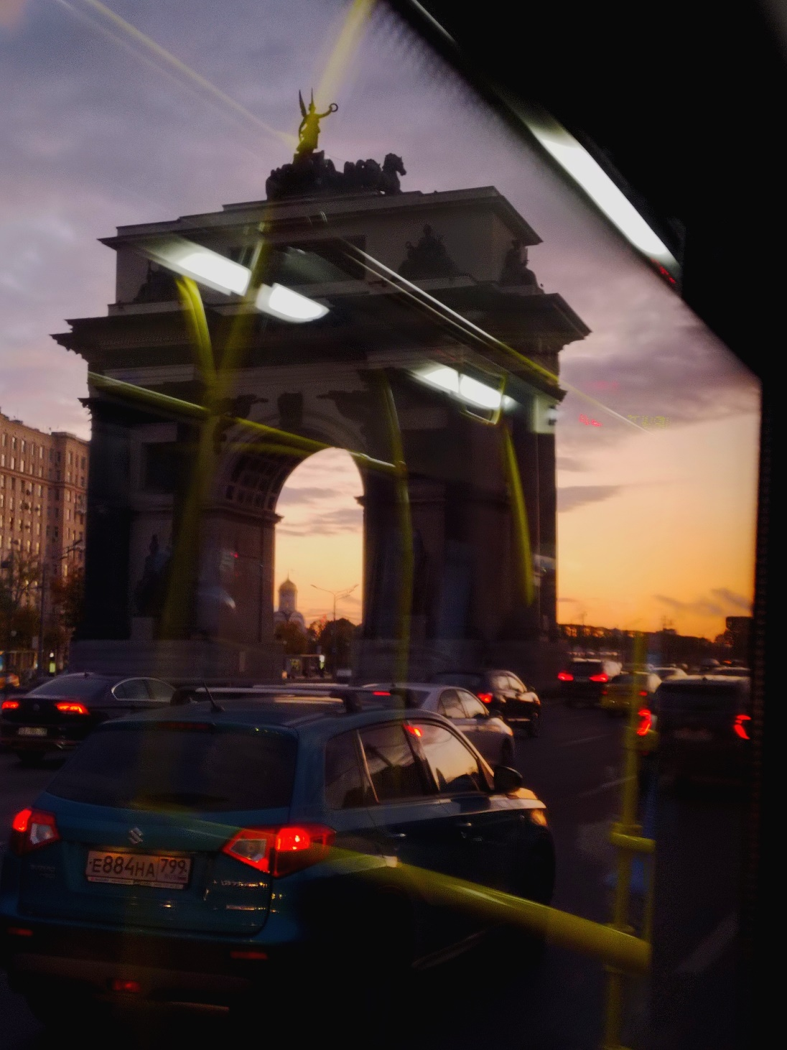
At the beginning of the 21st century, the Triumphal Gate needs restoration, and it was carried out in 2012. The territory around it was improved: the gardeners laid out new flower beds, engineers redesigned the system of artistic illumination. The renovated monument has become one of the gifts to Muscovites for the City Day.

